Slide 1
LAN, MAN & WAN

Slide 2
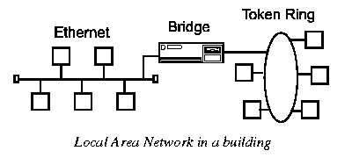
LAN

Slide 3
LAN (Local Area Network)
A Local Area Network (LAN) covers a small distance and a small number of computers.
A LAN often connects the machines in a single room or building.
Data transferred in High speed which ranges from 100 Mbps for system development and which is faster than MAN and WAN and have a low implementation cost.
Upper limit: 10 km ; Lower limit: 1 km
Twisted pair cable or Co-axial cable connects to the network.
Designed to share resources between PCs and workstation such as hardware or data.

Slide 4
Advantages of LAN
Cost reductions through sharing of information and databases, resources and network services.
Increased information exchange between different departments in an organization, or between individuals.
Improve the community security.
Increasing number and variety of intelligent data terminals, PCs and workstations.

Slide 5


LAN Topologies
Ring Topology
Bus Topology
LAN Topologies
Star Topology

Slide 6
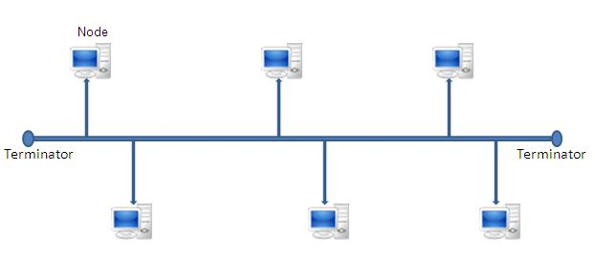
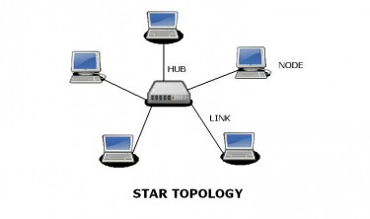
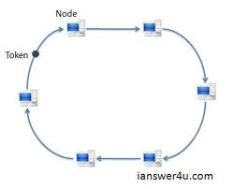
Bus Topology
Star Topology
Ring Topology

Slide 7
MAN (Metropolitan Area Network)
A Metropolitan Area Network (MAN) is a network that is utilized across multiple buildings
Commonly used in school campuses or large companies with multiple buildings
It is larger than a LAN, but smaller than a WAN
It is also used to mean the interconnection of several LANs by bridging them together.
A Metropolitan Area Network is a system of LANs connected throughout a city or metropolitan area.

Slide 8
MANs have the requirement of using telecommunication media such as voice channels or data channels.
Branch offices are connected to head offices through MANs. Examples of organizations that use MANs are universities and colleges, grocery chains, and banks.

Slide 9
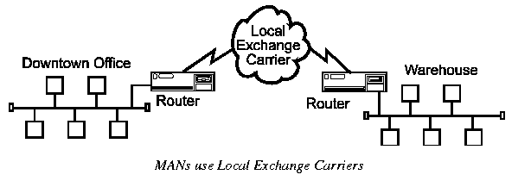

Slide 10
WAN (Wide Area Network)
The main difference between a MAN and a WAN is that the WAN uses Long Distance Carriers.
A Wide Area Network is a network spanning a large geographical area of around several hundred miles to across the globe.
May be privately owned or leased.
Also called “enterprise networks” if they are privately owned by a large company.

Slide 11
It can be connected through cable, fiber or satellite
It is typically slower and less reliable than a LAN
Services include internet, Intranet ,etc.

Slide 12
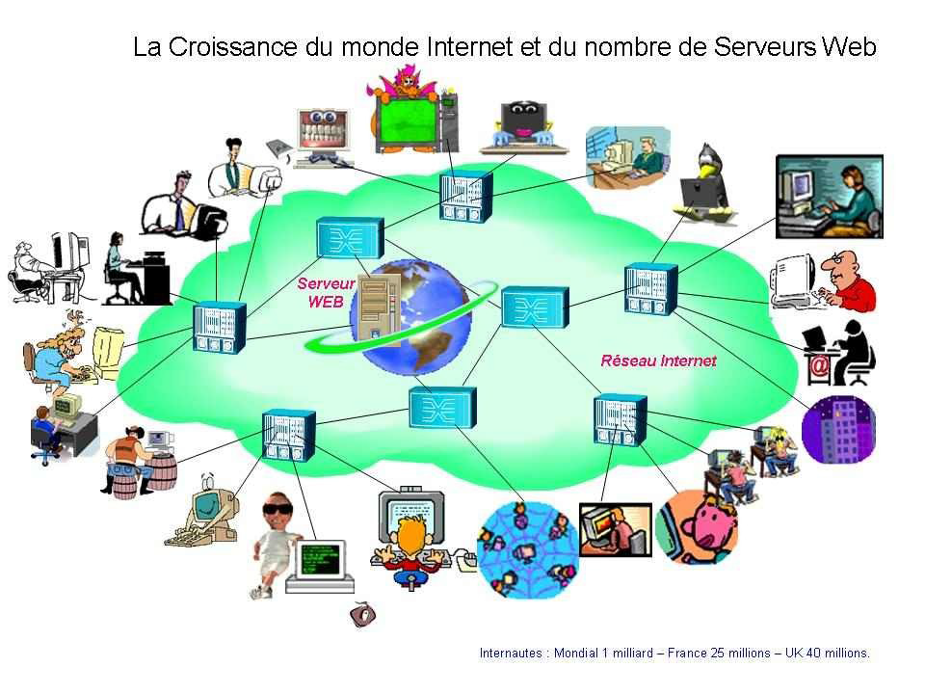

Slide 13
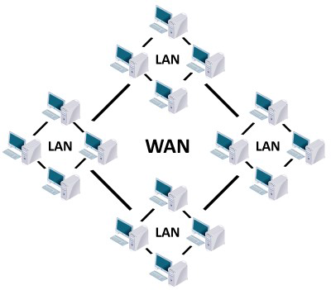
Difference between LAN & WAN

Slide 14
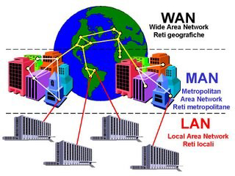
Difference between LAN, MAN & WAN

Slide 15
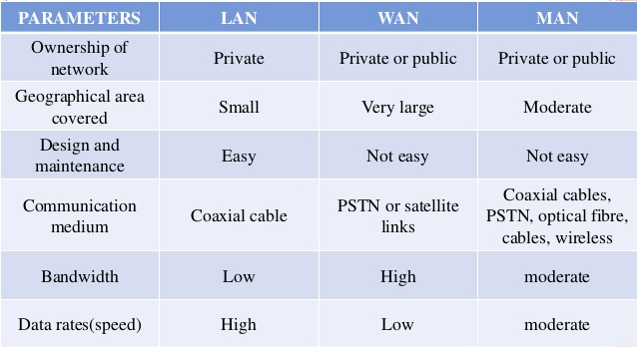
LAN Vs. MAN Vs. WAN

